Slide 1
SEATTLE CAR ACCIDENT SEVERITY CLASSIFICATION

Slide 2
The Problem
Traffic accidents are...
• Cause of 1.35 million deaths globally in 2016.
• Main cause of death among those aged 15–29 years.
• Predicted to become the 7th leading cause of death by 2030.
Predicting the accident severity in advance could be used to send the exact required staff and equipment to the place of the accident, thus saving a significant amount of lives each year. Road safety should be a prior interest for governments, local authorities and private companies investing in technologies that can help reduce accidents and improve overall driver safety.

Slide 3
DATA
All the recorded accidents in Seattle from the year 2004 to 2020. This data is regarding the severity of each accident, and has several attributes related to each accident.
The data has several features related to the accident such as Collision Type, Location, Fatalities and several features related to environmental conditions.
• Redundant and not relevant features were dropped • 48 features pre-selected
• On the data cleaning missing values are removed.

Slide 4
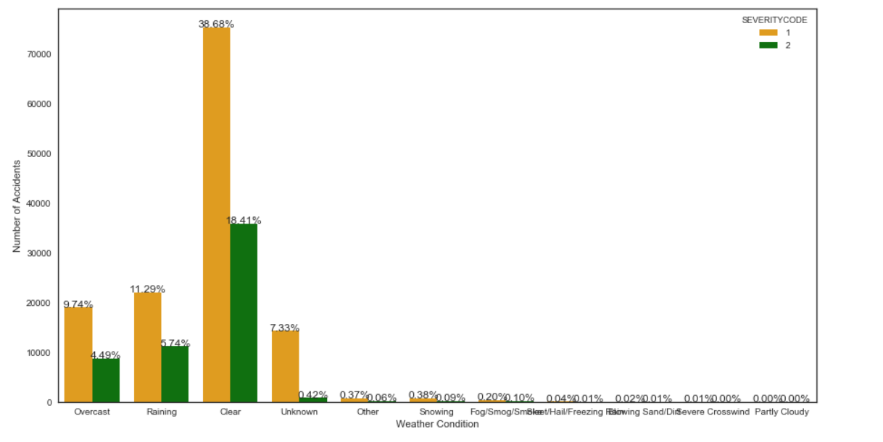
Data Visualization
Num. Of Accidients Under Different Weather Conditions
Surprisingly, most accidents seem to happen under clear weather conditions. Might indicate that people drive more carefully under less comfortable conditions.

Slide 5
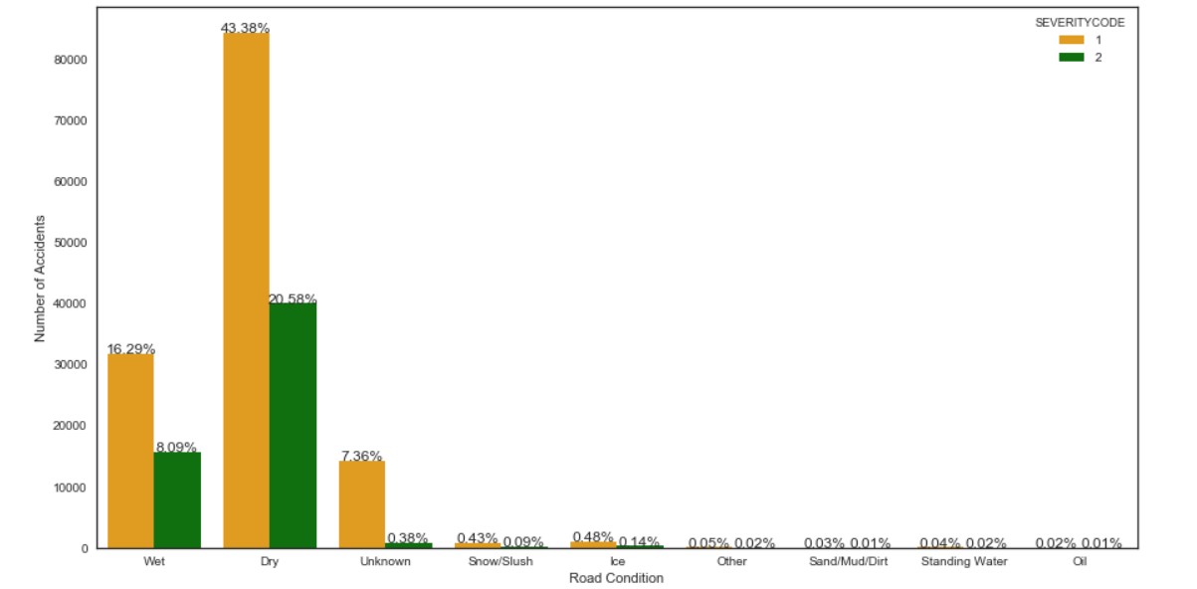
Data Visualization
Num. Of Accidients Under Different Road Conditions
Again surprisingly, but probably following the weather fact, most accidents take place on dry road conditions.

Slide 6
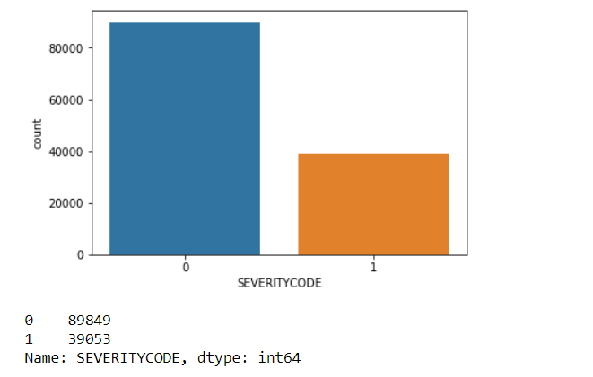
TARGET VARIABLE
As seen above, it is an imbalanced dataset which the majority class is ‘property damage’

Slide 7
HANDLING THE IMBALANCE
There are several options to handle the imbalanced dataset problem, such as sampling, penalizing the model for misprediction of the minority class, or chosing models that can handle the imbalance intrinsicly.
Random Under Sampling is chosen for this case since the number of observations are high enough, and in fact saving computation time is preferred.

Slide 8
MODEL SELECTION
After the dataset is balanced, 4 different machine learning models were evaluated based on f-1 score and jaccard similarity score.
Selected algorithms were KNN, SVM, XGBoost and Random Forest.
KNN was trained with k=250 approximately the sqrt(N) where N is the number of observations.
XGBoost and Random Forest are selected since research suggests they work well with imbalanced dataset and random undersampling.

Slide 9
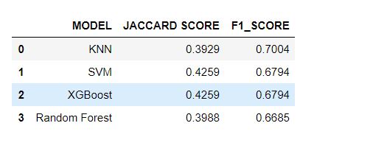
RESULT
The results show that the KNN model outperforms the rest however non of the models can be considered to perform very well.
The performance could be improved with more features that are more explainatory for the target variable.

Slide 10
DISCUSSION
Given the findings of exploratory analysis:
The authorities could:
Introduce more control in traffic during noon and within blocks, can increase the penalty for not granting pedestrian right.
Collect additional data on accidents such as vehicle speed on the time of accident, or visuals captured by traffic cameras that could help improve the classification model in the future.

